Slide 1

Thursday Special: Feature Engineering
Data Science Lifecycle
Week 8 : Feature Engineering On Financial data

Slide 2
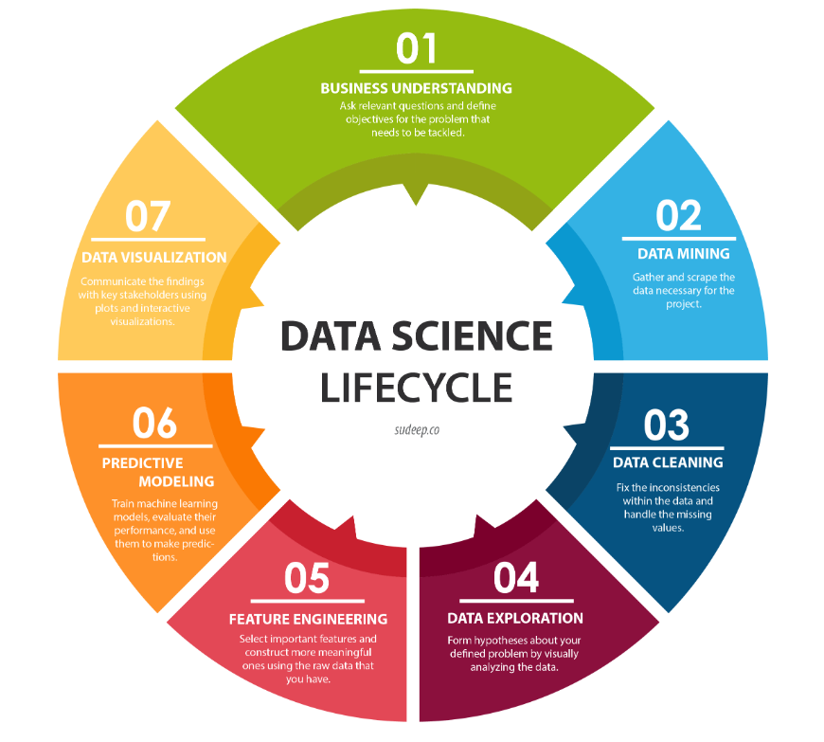
5. Feature Engineering ­◉ Fifth step of the Data Science life cycle is Feature Engineering

Slide 3
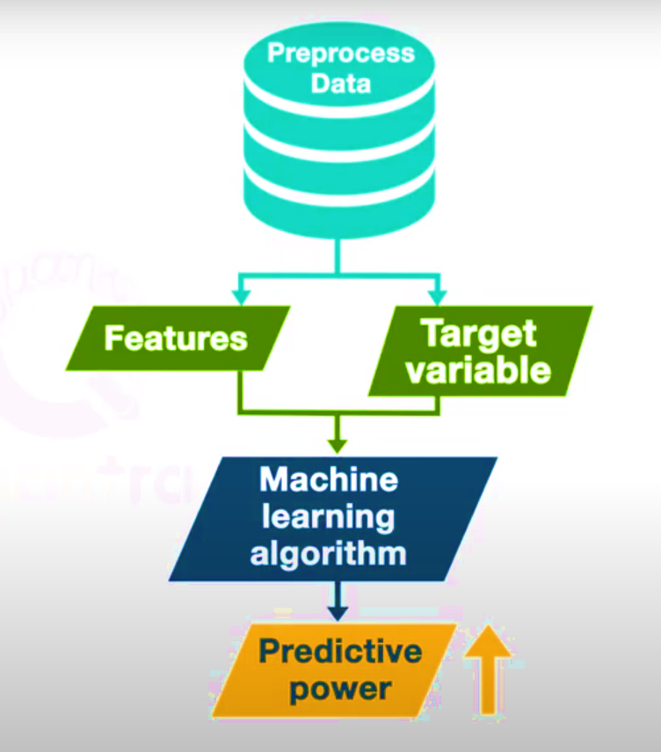
Feature Engineering
For optimal Predictive Modeling the Data Quality should be the no. 1 priority
A set of good quality engineered features can increase the accuracy of prediction

Slide 4
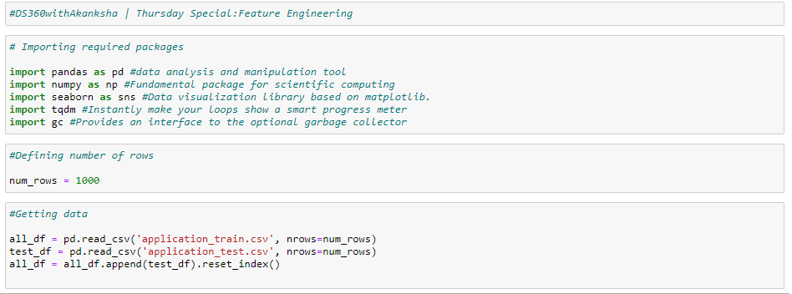
Feature Engineering
Started the feature Engineer exercise by importing required packages
Imported & appended the training and testing data

Slide 5
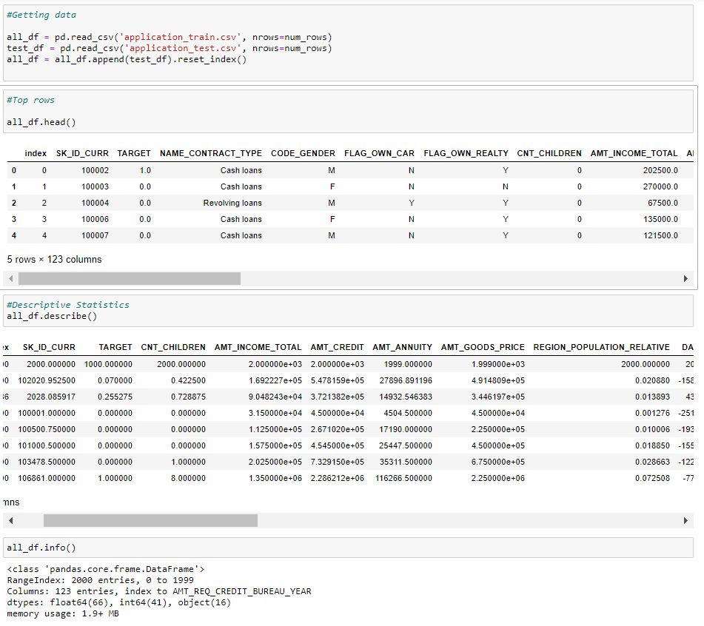
Feature Engineering
Reviewed the top rows
Looked into descriptive statistics
Checked the datatypes of the dataset

Slide 6
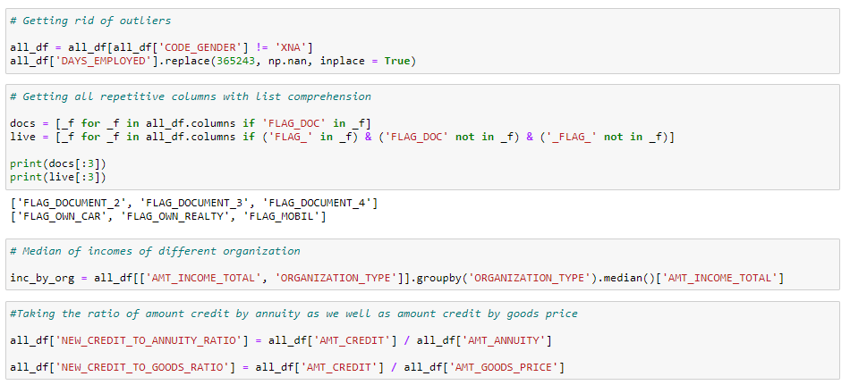
Feature Engineering
Removed outliers
Using list comprehension created list of columns with same keywords
Got the median of incomes of different organization
Took the ratios of annuity & goods

Slide 7
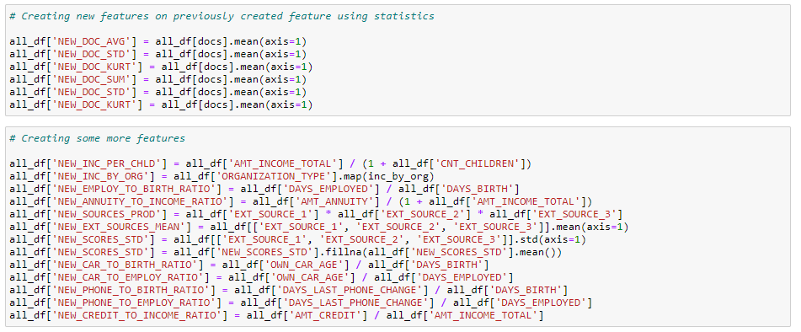
Feature Engineering
Created additional features

Slide 8
Next Step : 6. Predictive Modeling

Slide 9
References
http://sudeep.co/data-science/Understanding-the-Data-Science-Lifecycle/
https://quantra.quantinsti.com/startCourseDetails?cid=123&section_no=4&unit_no=1&preview=true#course_type=paid&unit_type=Video
https://www.youtube.com/watch?v=6L-Z3iqpBS0
https://www.youtube.com/watch?v=AVPf8TjHShQ
https://www.youtube.com/watch?v=hvflqHTWXVs
https://ieeexplore.ieee.org/stamp/stamp.jsp?arnumber=8743410
https://medium.com/@karanrajwanshi/feature-engineering-the-key-to-predictive-modeling-8f1935b3db4f
https://blog.bigml.com/2018/10/19/an-intuitive-guide-to-financial-analysis-with-data-transformations/
https://bigml.com/
https://www.kaggle.com/ogrellier/lighgbm-with-selected-features/code
https://www.kaggle.com/c/home-credit-default-risk
https://www.kaggle.com/c/home-credit-default-risk/data
https://towardsdatascience.com/feature-engineering-using-machine-learning-on-large-financial-datasets-8584dacd3a4d
https://towardsdatascience.com/stock-market-data-collection-feature-engineering-using-python-f201d8a4e8d7
https://db.nomics.world/
https://github.com/addisonlynch/iexfinance
https://alphascientist.com/feature_engineering.html
https://tqdm.github.io/
https://docs.python.org/3/library/gc.html
https://seaborn.pydata.org/
https://numpy.org/
https://pandas.pydata.org/

